Slide 1

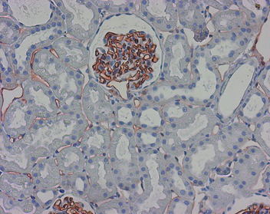
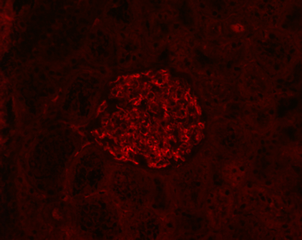
ReliaTech GmbH
Mouse anti-rat Aminopeptidase P (#JG12)
(Cat# 104-M01)
Figure 1: Staining of Aminopeptidase P in the tubulointerstitial blood vessels and in particular the blood vessels of the glomerulus (paraffin-embedded tissue-sections fixed in formalin) with anti-rat Aminopeptidase P [Cat# 104-M01].
Figure 2: Immunofluorescence staining of endothelial cells of the glomerulus as well as the tubulointerstitial blood vessels (here very weak) (paraffin-embedded tissue-sections fixed in formalin) with anti-rat Aminopeptidase P [Cat# 104-M01].
http://www.reliatech.de / orders@reliatech.de

